Slide 1
Kubernetes - Configuration

Slide 2
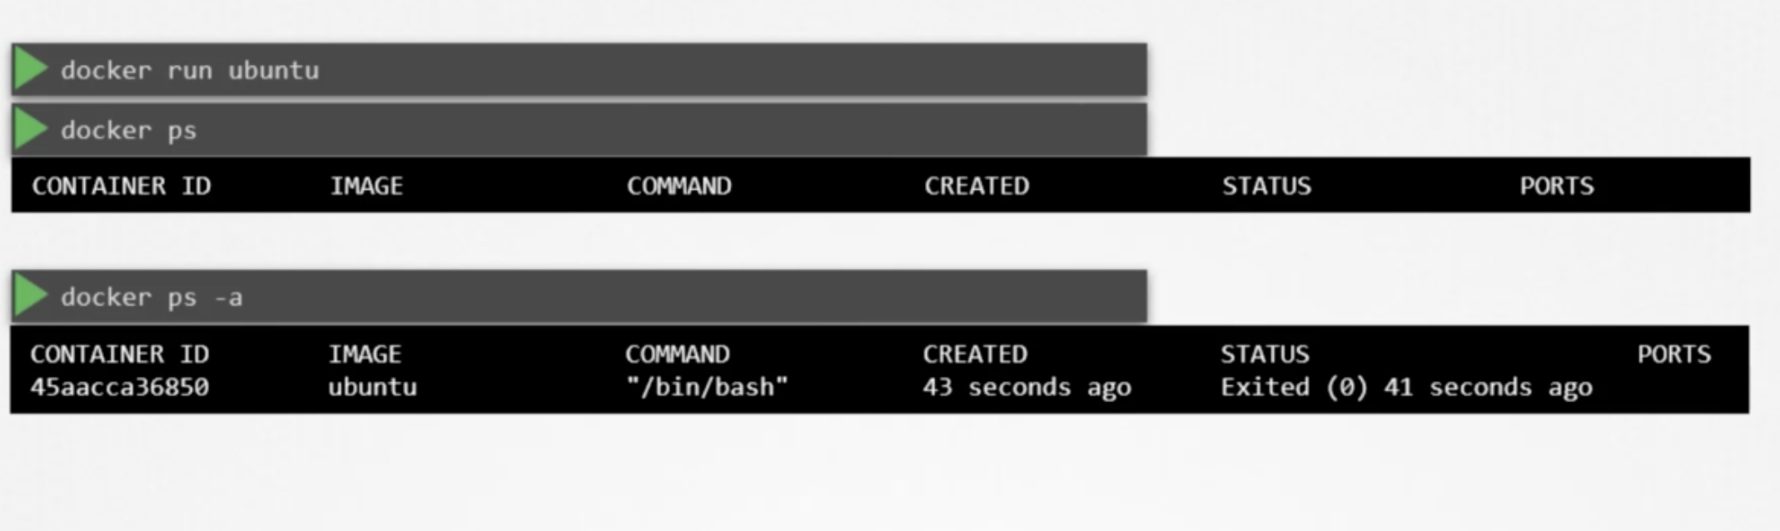
Commands in Docker
docker run ubuntu -> runs a container with ubuntu on it, but it exits

Slide 3
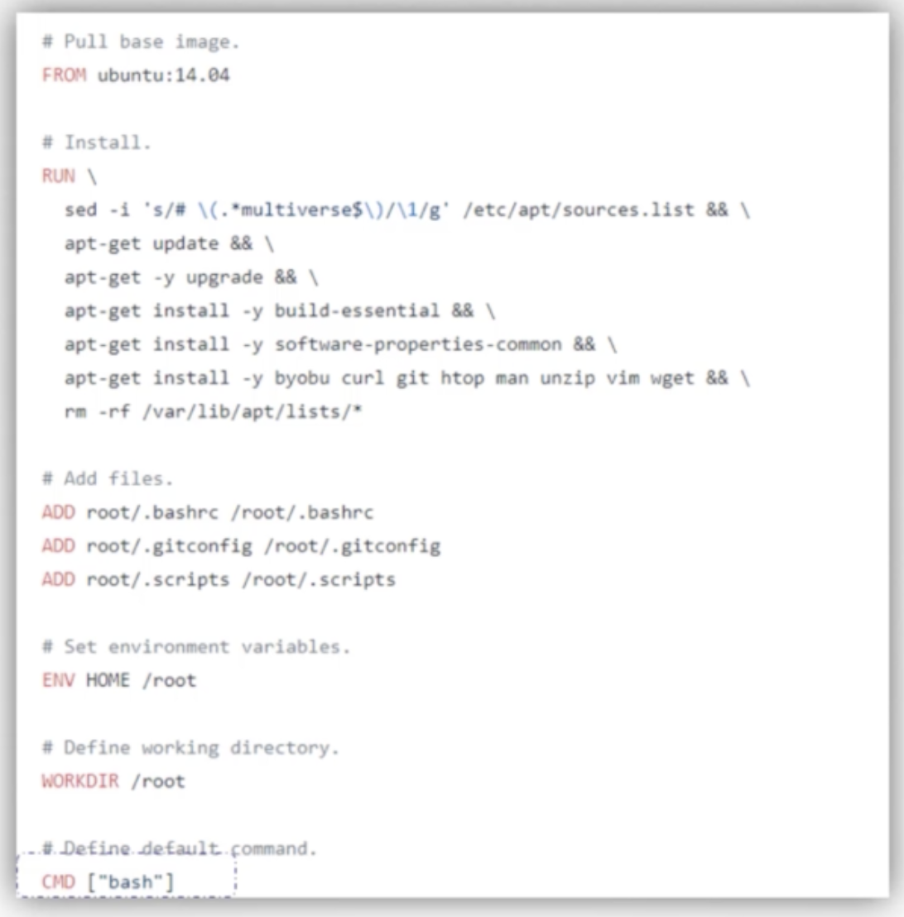
Commands in docker
Ubuntu base image looks for terminal due to bash command

Slide 4
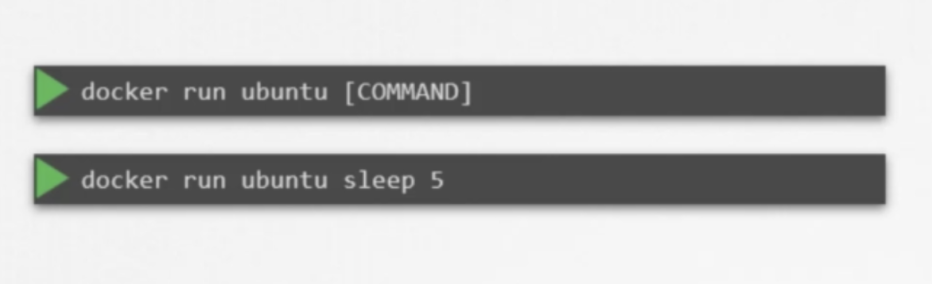
Commands on Docker

Slide 5
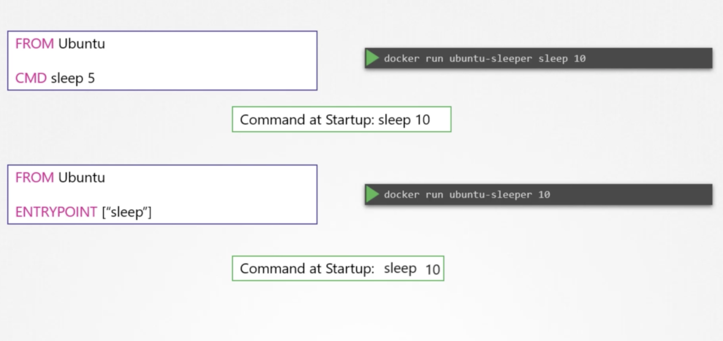

Slide 6
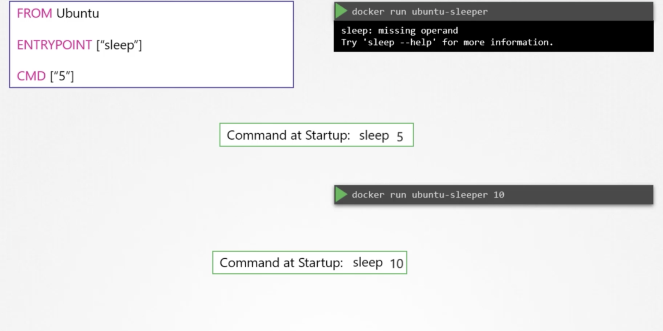

Slide 7
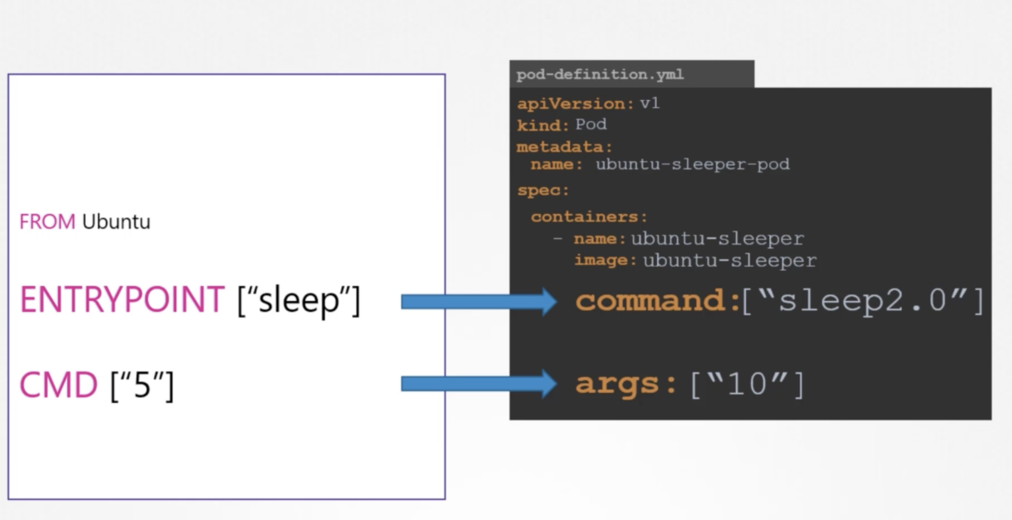
K8s command equivalent

Slide 8
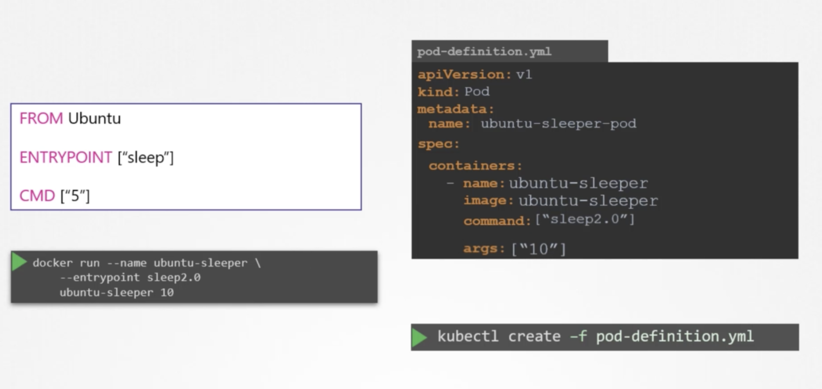

Slide 9
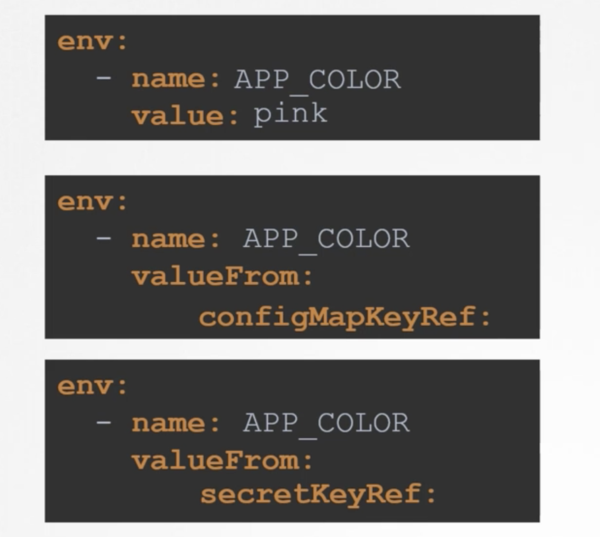
Env variables
Added as a list in definition file

Slide 10
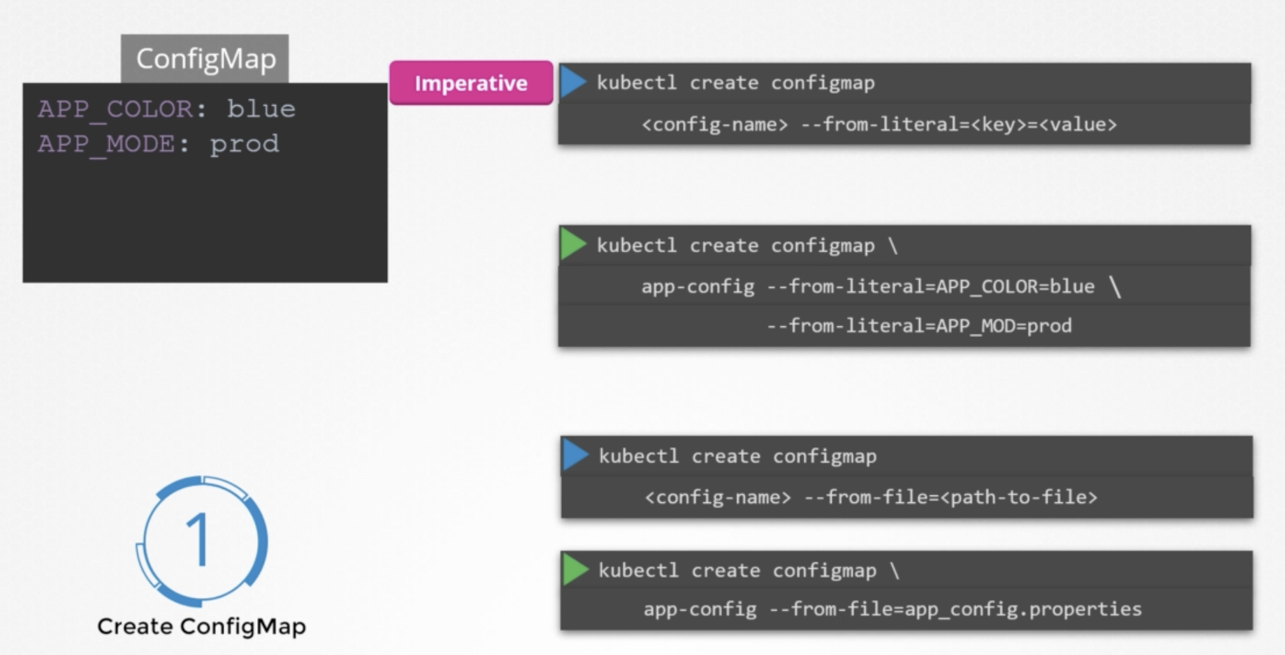
Config maps
To configure apps and pass it in “envfrom”

Slide 11
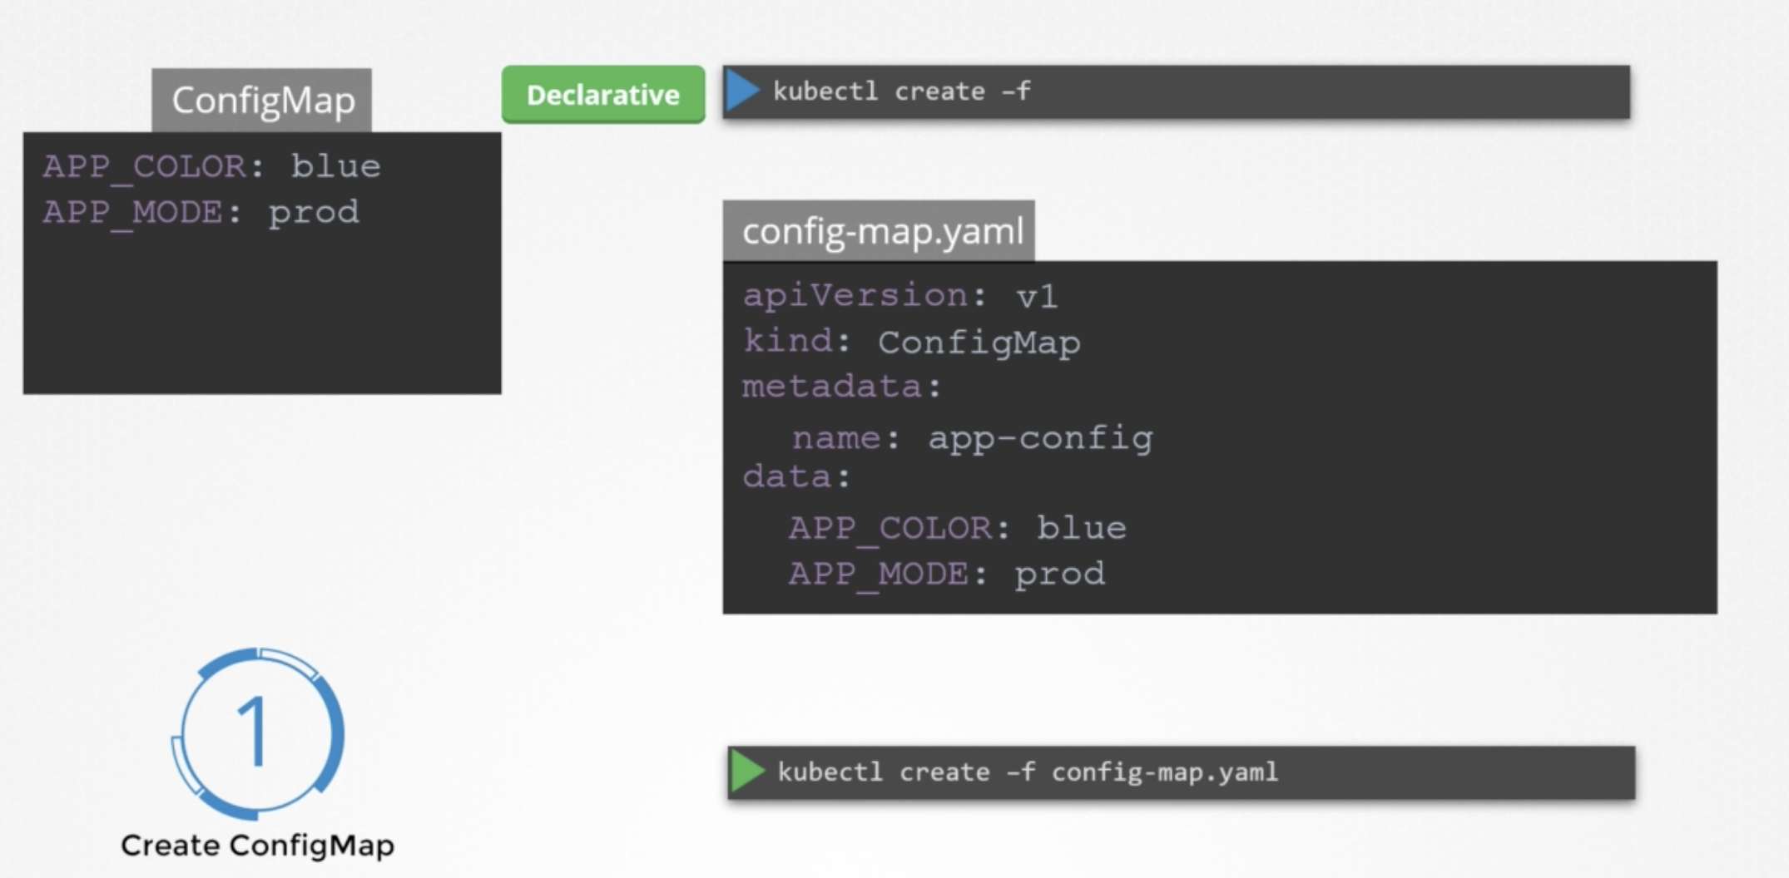
Config Maps
Declarative way:

Slide 12
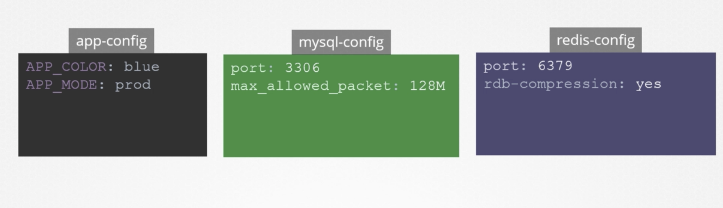
Config map examples

Slide 13
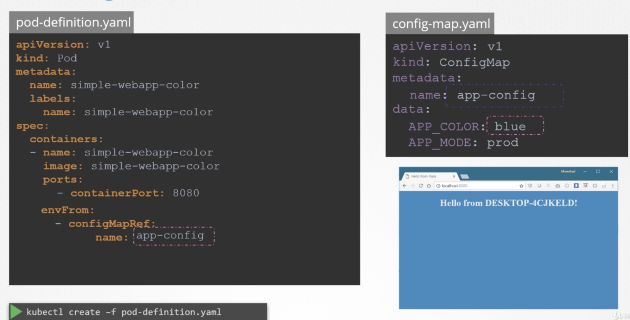
Final result

